Slide 1

CAPSTONE PROJECT ON EXCEL
Pubg Statistics dashboarding using excel
By: MEHUL SAKLANI

Slide 2
PROBLEM STATEMENTS
Kills made in different types of matches.
Matches played in different maps.
Damage dealt by the gun & longest kill with the same gun.
Survivals
Top players and their distance travelled.
Kills by different types of guns.
Kills types (Road kills , head-shot kills)
Number of matches according to match type.
Top players and their highest damage dealt.
Squad win % and damage based on ranks.
Number of times a player was knocked out.
Average kill points scored according to kill ranks.
Number of times boosts & heals consumed.
Weapons distribution Aquired by win points.
#SOURCE OF DATA
https://www.kaggle.com/datasets

Slide 3
OUTCOME / RESULT OF THE ANALYSIS
We have explored data and identified the meaningful insights and have them displayed on our dashboard.
Statistical analysis depicting problem and solving them for each player just by the datasets given is awesome. Hence analysis on PUBG Dataset tell us that there can be many problems and hence their solutions.
Players that played well and their statistics.
We’ve created pivot charts from the data . We created a dashboard in EXCEL containing all the charts together , giving a glance overview of project . Dashboard shows views of all problem statements.
DRIVE LINK EXPLANATION:-
http://surl.li/ajmwb

Slide 4
DATA VISUALISATION
1.DAMAGE DEALT AND LONGEST KILL BY GUN
Damage dealt with guns ,who made a longest distance kill in metres and damage dealt according to the data given.

Slide 5
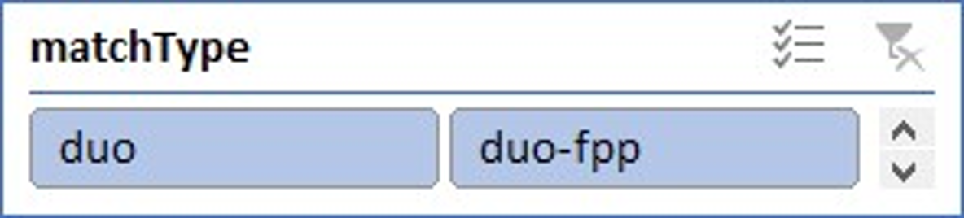
2.MATCHES PLAYED IN DIFFERENT TYPES OF MAPS
This pie chart depicts matches played held in Erangel and Miramar maps.
Chart varies based on slicer of MATCH TYPE.

Slide 6
3.SURVIVALS
Top players who have survived till last minute of a match.
This varies based on Match types which we have taken as a slicer.

Slide 7
4. DISTANCE TRAVELLED BY TOP PLAYERS
Walk Distance is a critical factor in winning. As the running speed is almost static. So if you have to be in top winning places you have to keep on moving. The walking distance is directly proportional to chance of winning.
These are the top players for distance travelled by swimming , walking , riding on vehicle.

Slide 8
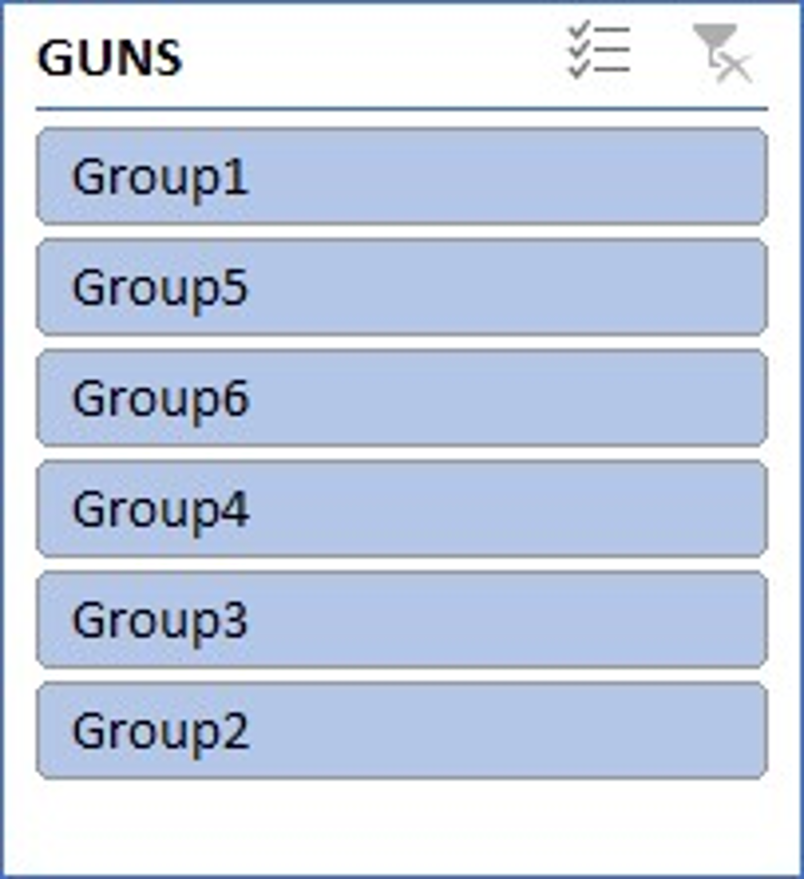
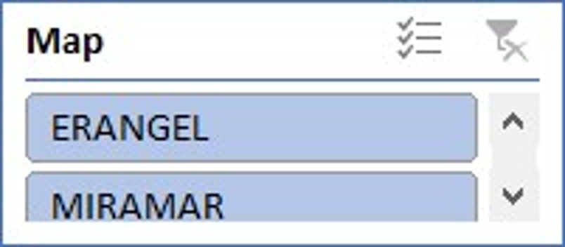
5.KILLS MADE BY DIFFERENT TYPES OF GUNS
This pie chart depicts info of number of kills by different gun .
This varies based on GUNS and MAPS which we have taken as a slicers.

Slide 9
6. TYPES OF KILLS
Headshot kills tell about how good that player is.
Here line chart tells about top players who made headshot kills and road kills.

Slide 10
7. MATCHES CONDUCTED IN MATCH TYPES
This bar chart represents number of matches conducted according to match type.

Slide 11
8. DAMAGE DEALT
This chart represents top players who have dealt with highest damage.

Slide 12
9.DAMAGE BASED ON RANK POSITIONS AND WIN PERCENTAGE
Here line chart says the average damage given by that rank position members.
Column chart represents Win Percentage .

Slide 13
10. NUMBER OF TIMES A PLAYER WAS KNOCKED OUT
This pe chart depicts that how many times a player was knocked out.
Taking the legends as number of times a player was knocked out.

Slide 14
11. AVERAGE KILL POINTS
This area chart represents the average kill points players has scored based on kill ranks.

Slide 15
12. BOOSTS AND HEALS CONSUMED
Boosts also should be a important factor. If you want to live more time , it is highly likely that you use one or more boosts.
This chart says Boosts and heals taken by a player to increase his performance in the game.

Slide 16
13. DISTRIBUTION OF WEAPONS ACQUIRED BY WIN POINTS
This chart represents number of weapons players has acquired based on win points.

Slide 17
14.VEHICLES DESTROYED BY GUNS
This chart depicts guns which have destroyed most number of vehicles.

Slide 18
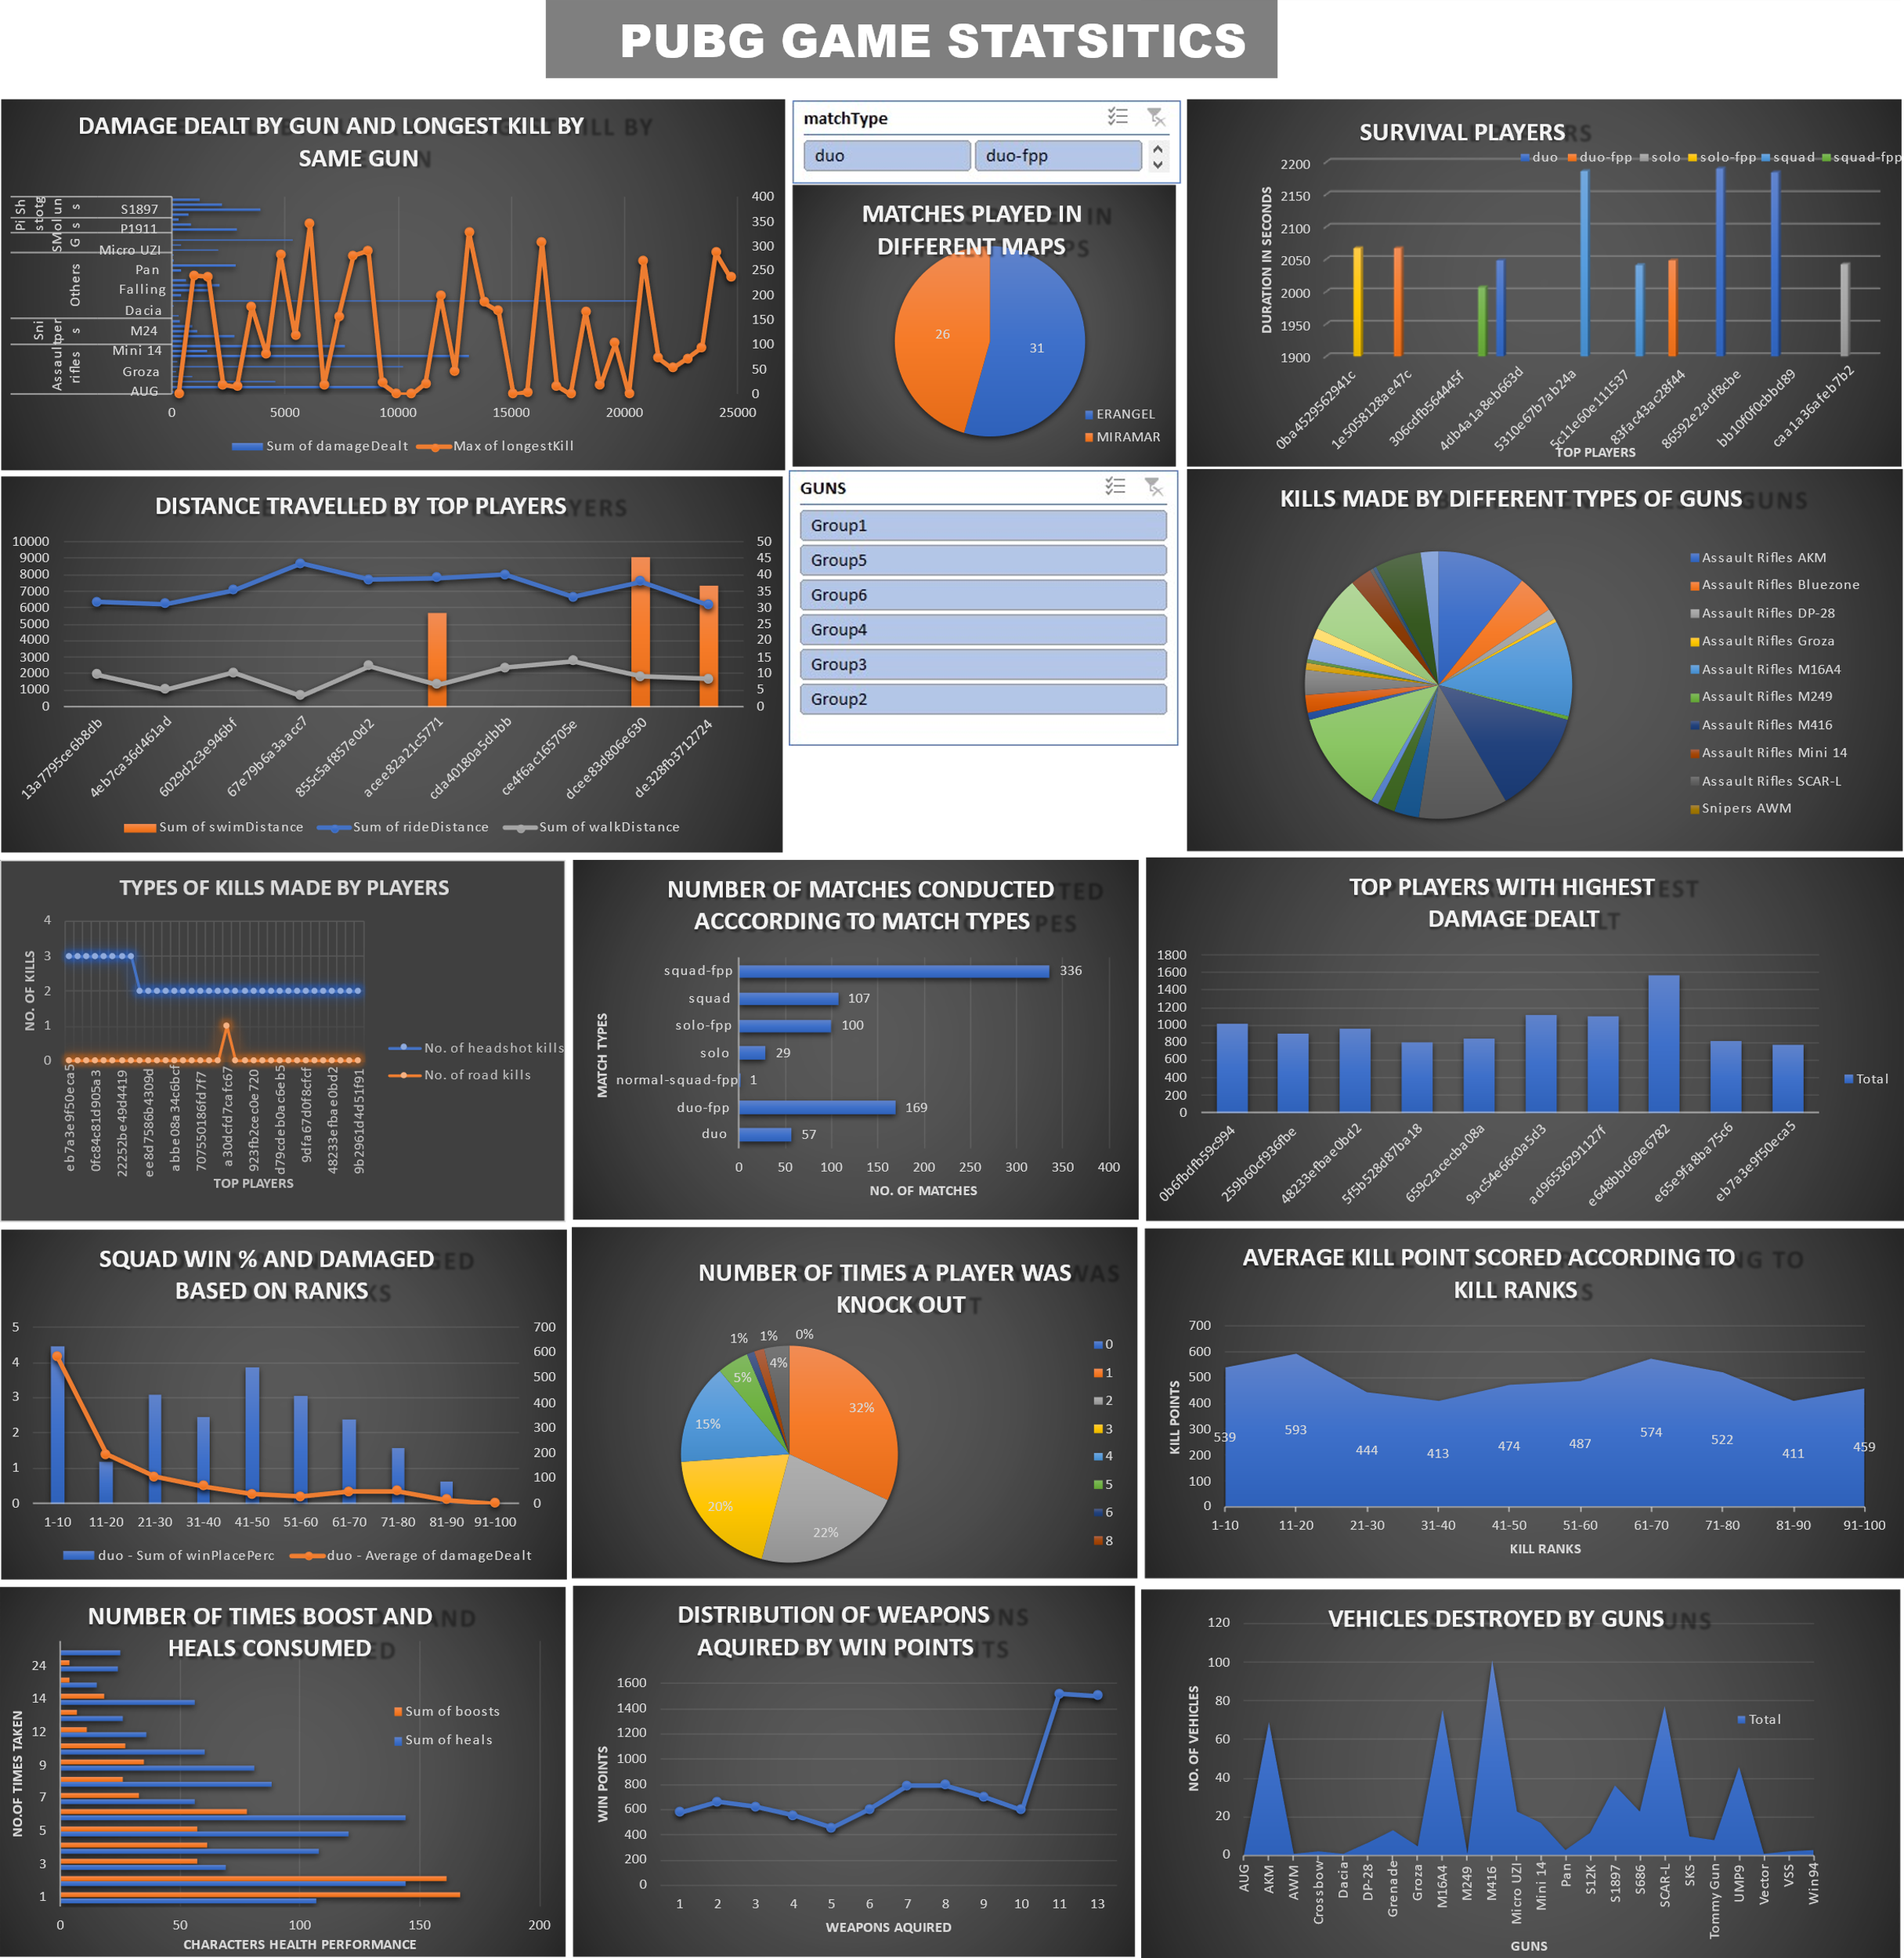
DASHBOARD

Slide 19
CONCLUSION
DATASETS contains PUBG statistical value, formatted such that each row contains one player’s post-game statistics. The data contain matches of all types: solos, duos, squads, and FPP.
Each matches has information of players and their statistics are summarized. Which includes various aggregate statistics such as player kills, damage, longest survival , distance travelled etc.
Thus, it conclude that we have created a detailed analysis from information by forming charts and leading to creation of dashboard.
#NEXT STEPS
We can further continue this project by taking dates as labels , kill ratio determining the level of gaming .

